Slide 1


Mangrove Guardian: Community Mangrove Watch.
Hackout'25
Participatory Monitoring for Mangrove Protection
#CodeSmashers

Slide 2


The Urgent Need for Mangrove Protection
Mangrove forests are vital ecosystems, serving as natural barriers against storms, critical habitats for diverse marine life, and powerful carbon sinks. They are a frontline defense against climate change and coastal erosion.
However, these invaluable ecosystems are under severe threat from illegal logging, unsustainable land reclamation for development, and rampant pollution. These activities lead to rapid deforestation and degradation, jeopardizing both the environment and the communities that depend on them.
Mangrove Guardian offers a critical solution: a participatory platform designed for real-time monitoring and reporting of threats, validated by AI, and sustained through gamification, this system empowers communities to become active guardians of their local mangroves.

Slide 3





Empowering Communities: Target Users & Impact
Mangrove Guardian is designed for a broad spectrum of stakeholders, ensuring maximum reach and impact in mangrove conservation efforts.
Coastal Communities
NGOs & Conservationists
Local residents and indigenous groups, often the first to notice changes and threats to mangroves.
Organizations dedicated to environmental protection, needing reliable data for advocacy and action.
Government Authorities
Researchers
Environmental agencies and law enforcement responsible for policy implementation and enforcement.
Scientists studying mangrove health, biodiversity, and carbon sequestration.
Significant Impact:
Faster surveillance and response times, community empowerment, and robust data for enforcement actions. This proactive approach can prevent the release of 100+ tons of CO2 annually from protected mangrove areas. For inclusivity, an SMS fallback ensures access for low-tech communities.

Slide 4
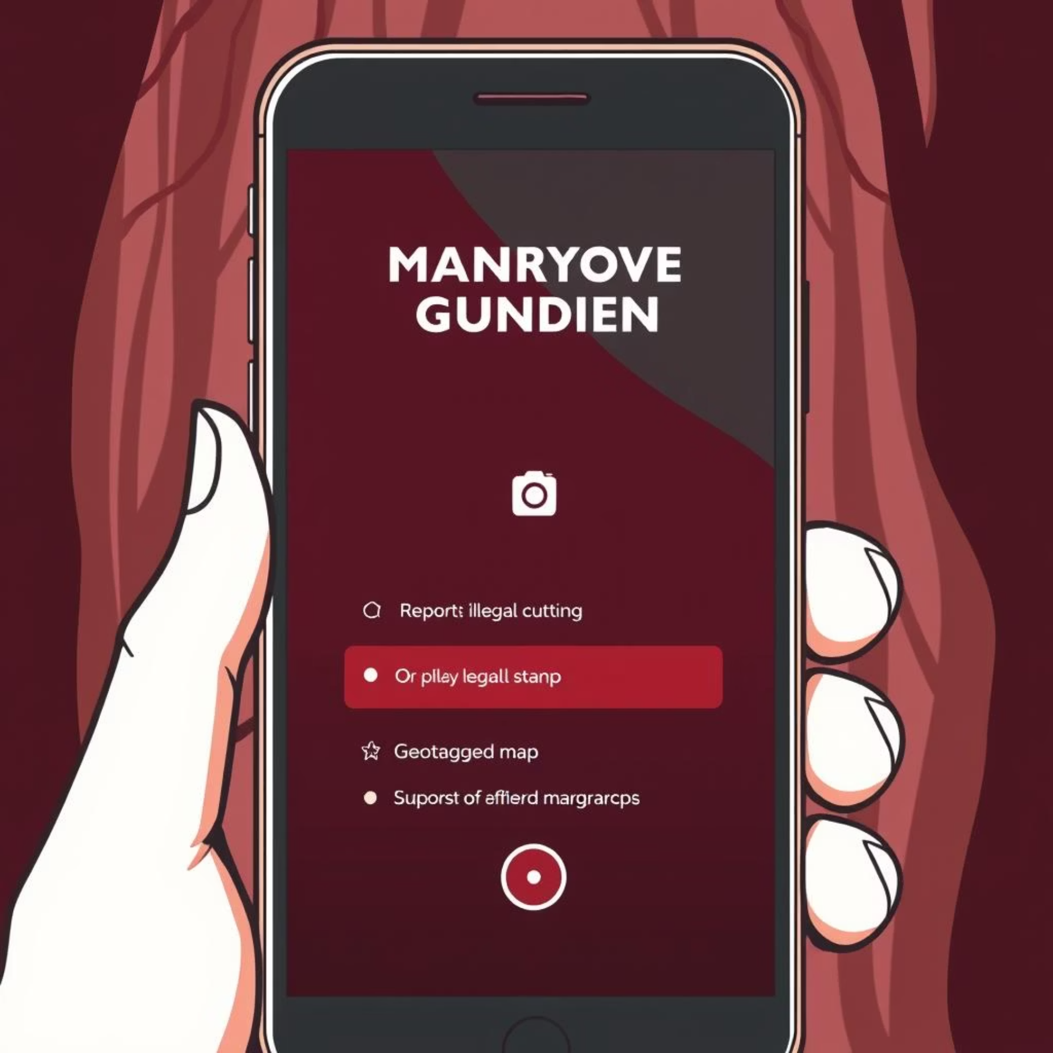

Seamless Reporting: The User Interface
The reporting interface is designed for simplicity and efficiency, enabling anyone to report threats with ease.
Purpose:
To provide a quick and intuitive way for community members to report threats like illegal cutting, pollution, or unusual activities in mangrove areas.
Key Features:
Geotagged Photos: Automatically captures location for precise reporting.
SMS Fallback: Ensures reporting capability even in areas with limited internet access.
Multilingual Support: Caters to diverse local populations.
How It Works:
Users simply open the app (or send an SMS), select the type of threat, add a photo, and submit. The data is instantly sent to our backend system for validation.
Real-Life Scenario: A fisherman at sea spots illegal logging. With Mangrove Guardian, they can send a quick, geolocated report, even via SMS, within minutes, allowing authorities to intervene swiftly.

Slide 5
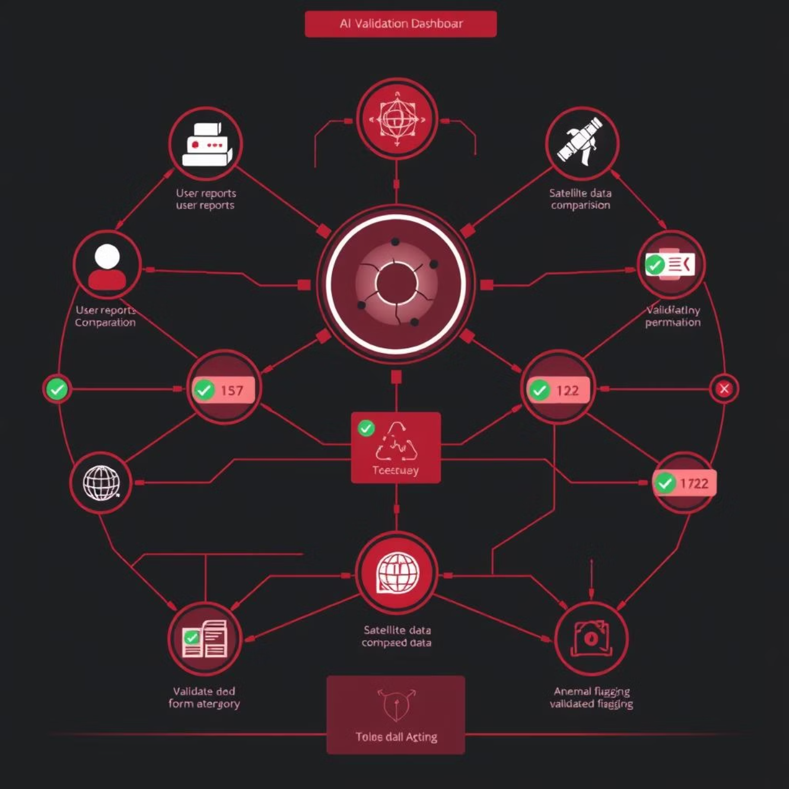

Intelligent Validation: AI & Anomaly Detection
To ensure the integrity and reliability of reported data, Mangrove Guardian employs advanced AI-driven validation and anomaly detection.
Purpose:
To ensure the accuracy of reported incidents and build trust in the system, minimizing false alarms and directing resources effectively.
Key Features:
AI Cross-Verification: Automatically compares reported images and locations with satellite data (e.g., Google Earth Engine imagery) to detect changes or anomalies.
Trust Scores: Assigns a reliability score to each report based on historical accuracy of the reporter and AI confidence levels.
How It Works:
Once a report is submitted, our backend AI system flags potential anomalies or low-confidence reports. These are then routed for manual review by designated NGOs or community leaders if needed, ensuring a human touch point for complex cases.
Real-Life Application: This intelligent filtering achieves over 80% accuracy in initial validation, significantly reducing the workload for human reviewers and preventing "noise," similar to how iNaturalist validates biodiversity observations.

Slide 6

Sustained Engagement: The Gamification System
To encourage continuous participation and build a dedicated community, Mangrove Guardian integrates a robust gamification system.
1
2
Points for Reports
Leaderboards
Users earn points for every valid report submitted, with bonus points for verified threats.
Publicly displayed rankings of top reporters, fostering healthy competition and recognition.
3
4
Badges & Achievements
Redeemable Rewards
Digital badges awarded for milestones (e.g., "First Responder," "Mangrove Hero"), enhancing intrinsic motivation.
Points can be exchanged for tangible rewards, potentially provided by local businesses or environmental partners.
How It Works: The backend system tracks all user actions—reports, verifications, and community engagement—and updates points and rankings in real-time. This dynamic feedback loop keeps users engaged and motivated.
Proven Impact: Similar to Duolingo's successful model, gamification can boost user retention and engagement by an estimated 40%, transforming passive observers into active guardians.

Slide 7
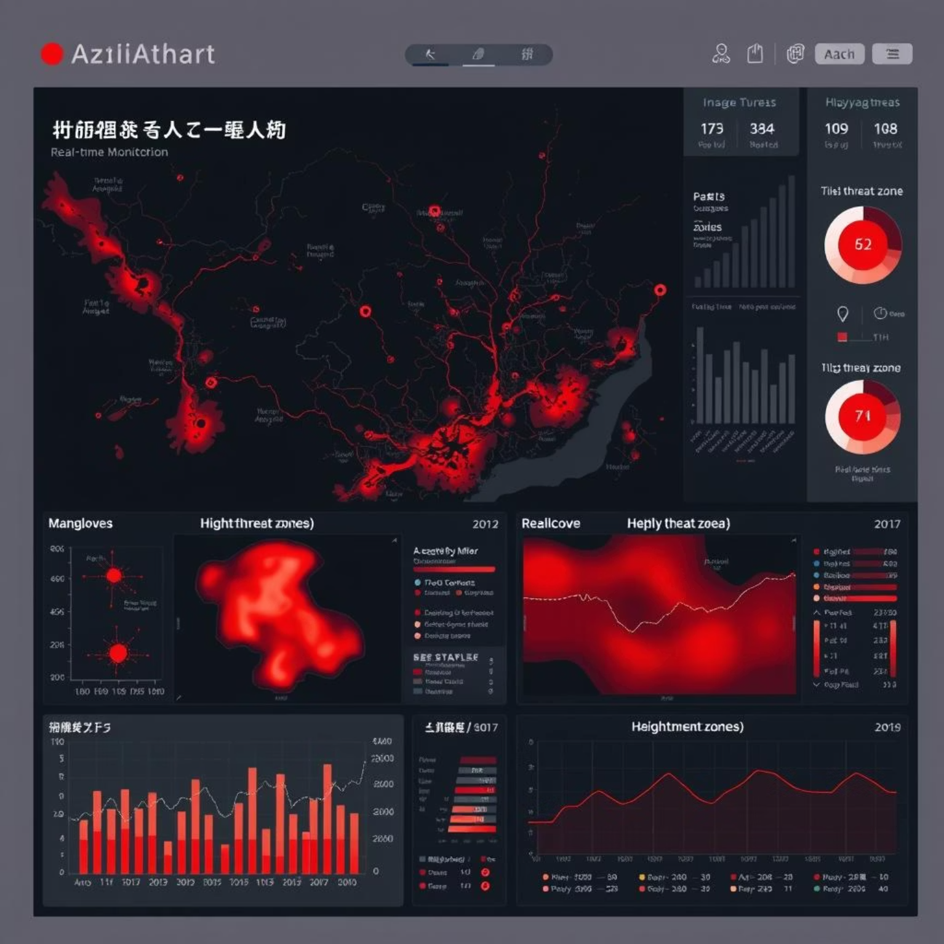


Centralized Control: Dashboard for Authorities
For swift and effective action, validated threat data is aggregated into a comprehensive dashboard for relevant authorities and response teams.
Purpose:
To provide government agencies and enforcement bodies with a real-time, centralized view of all verified mangrove threats, enabling rapid response and strategic planning.
Key Features:
Real-Time Maps: Displays incident locations with details and status updates on an interactive map.
Heatmaps: Visualizes areas with high concentrations of reported incidents, highlighting hotspots.
Customizable Alerts: Notifies relevant personnel via email or SMS for critical reports.
Exportable Reports: Allows for easy generation of reports for legal action or administrative purposes.
How It Works: The dashboard dynamically pulls validated data from the backend, pushing critical notifications to relevant officials. This empowers them to dispatch rapid patrols and coordinate interventions, much like disaster management applications facilitate quick emergency responses.

Slide 8









Robust Architecture: Integration & Security
The Mangrove Guardian system is built on a foundation of seamless integration and stringent security measures to ensure data integrity and user trust.
API Connections
Data Encryption
Standardized APIs facilitate secure data exchange between all system components.
All data in transit and at rest is encrypted to protect sensitive information.
Audit Trails
Data Anonymization
Comprehensive logging ensures accountability and traceability of all actions within the system.
Personal user data is anonymized where possible to protect privacy and comply with regulations.
How It Works: From initial reporting to AI validation and authority dashboards, all modules are connected via secure APIs. This ensures consistent, real-time data flow. Robust authentication protocols prevent unauthorized access, building user trust and ensuring compliance with data protection laws.

Slide 9
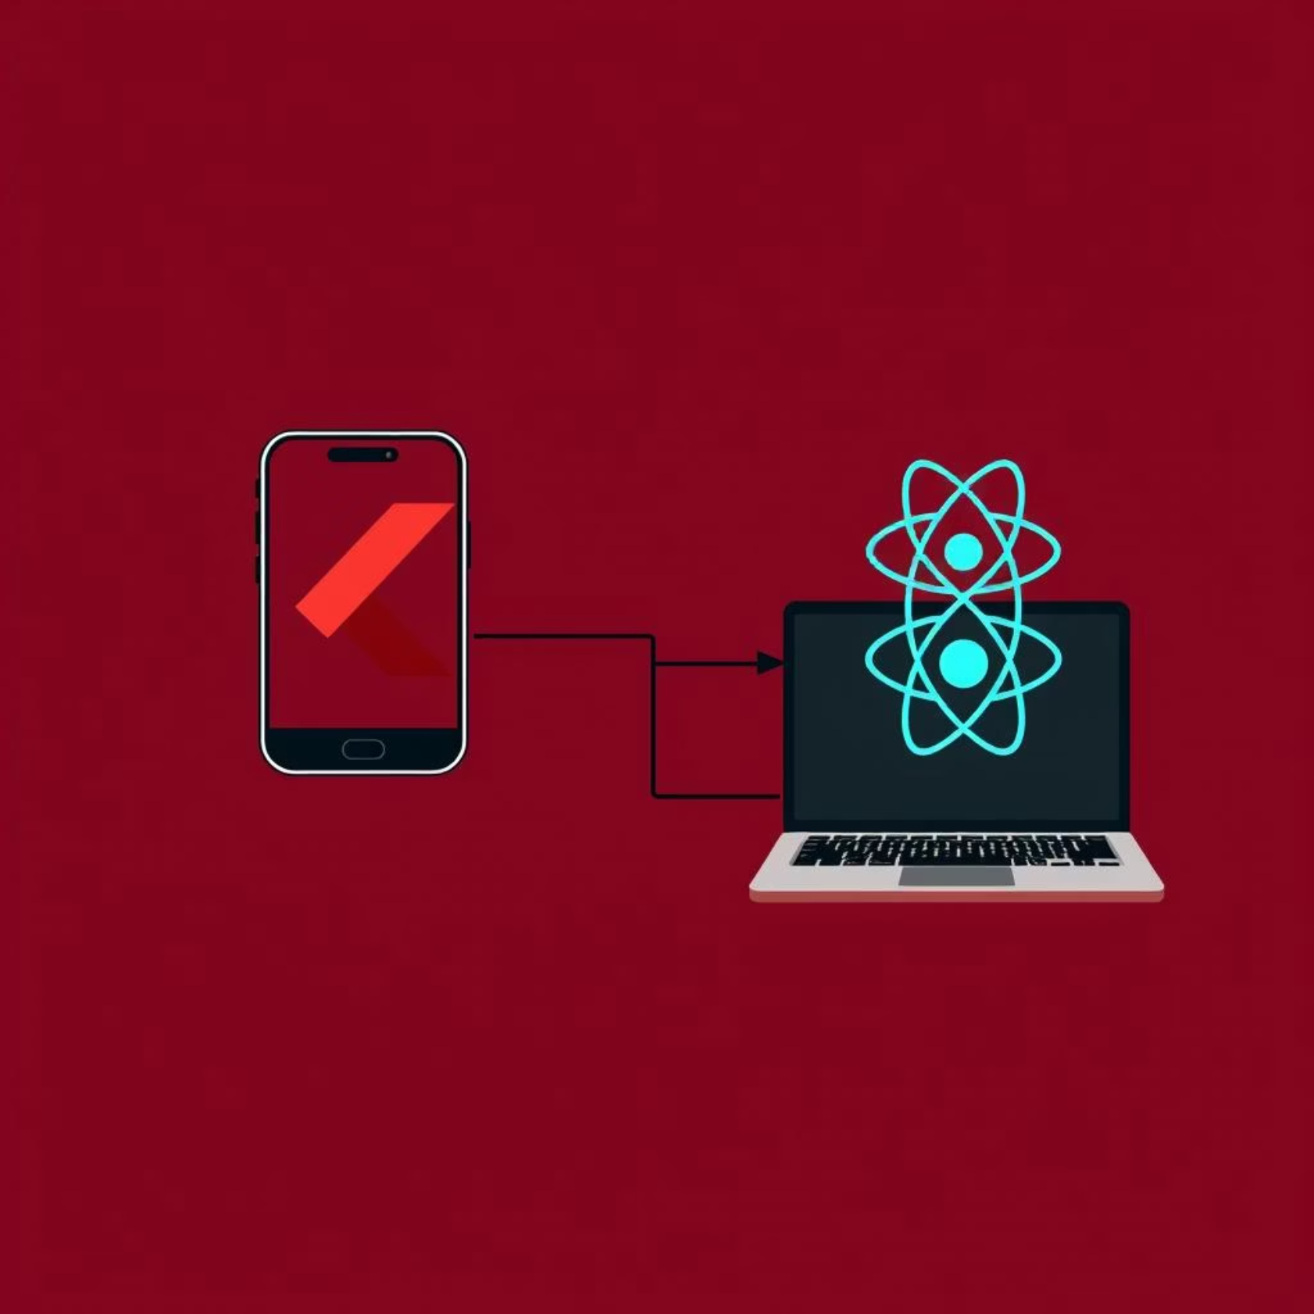
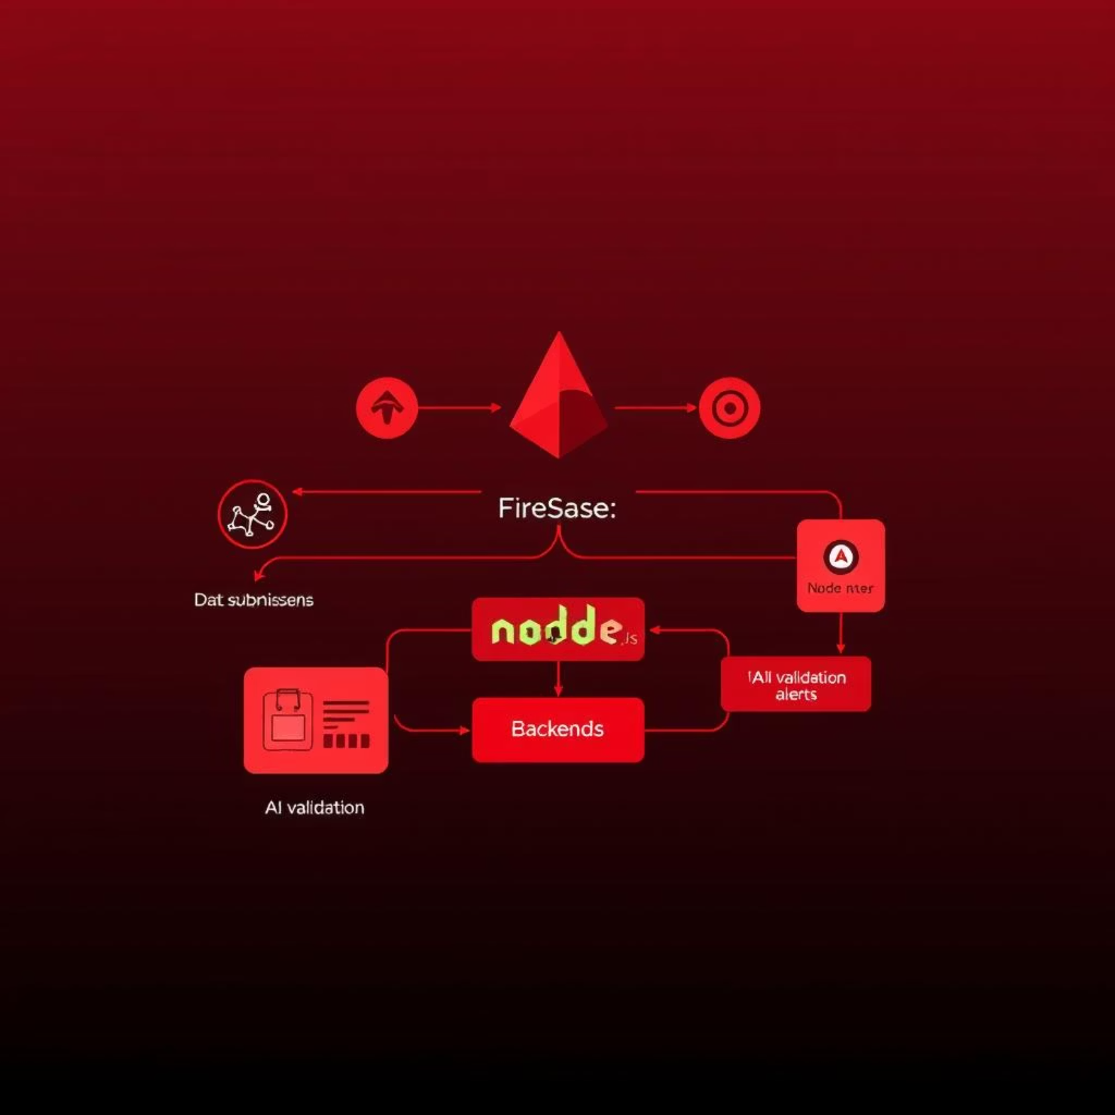

Technical Foundations: Frontend & Backend
Mangrove Guardian leverages modern, efficient technologies to deliver a responsive and scalable solution.
Frontend: User Experience
Backend: Data Processing & Logic
Mobile App: Developed with Flutter, enabling a single codebase for iOS and Android, providing a native-like experience.
Core Logic: Powered by Firebase for serverless functions and real-time database capabilities, complemented by Node.js for custom business logic.
Web Dashboard: Built with React.js for a dynamic and interactive user interface for authorities and NGOs.
Functionality: Handles all incoming report submissions, executes AI validation processes, manages gamification updates, and dispatches alerts to authorities.
Key Implementations: Geotagging is seamlessly integrated using Flutter packages, and interactive maps on the web dashboard leverage React Leaflet.
Build Time: The frontend was designed and implemented within 6-8 hours, focusing on a responsive and intuitive UI across devices.
Build Time: The backend infrastructure was set up and configured within 4-6 hours, ensuring efficient and real-time data processing.

Slide 10





Future Vision & Next Steps
Mangrove Guardian is more than just a hackathon project; it's a foundation for a scalable, impactful solution.
Scalability & Robustness
MVP Focus
Designed to be cloud-ready, ensuring it can handle a growing number of users and data points. Future efforts will include load testing and optimization.
Our 24-hour build prioritized the core reporting and validation flow. Next steps involve refining the UX and adding more advanced features.
Community Expansion
Pilot Programs & Partnerships
Grow the network of 'Mangrove Guardians' through outreach, education, and continued gamification incentives.
Seek out coastal communities and NGOs for pilot implementations. Establish formal partnerships with government agencies and environmental organizations.
Ready to Build?
We are excited by the potential of Mangrove Guardian and are ready to collaborate to bring this solution to life.

